Slide 1
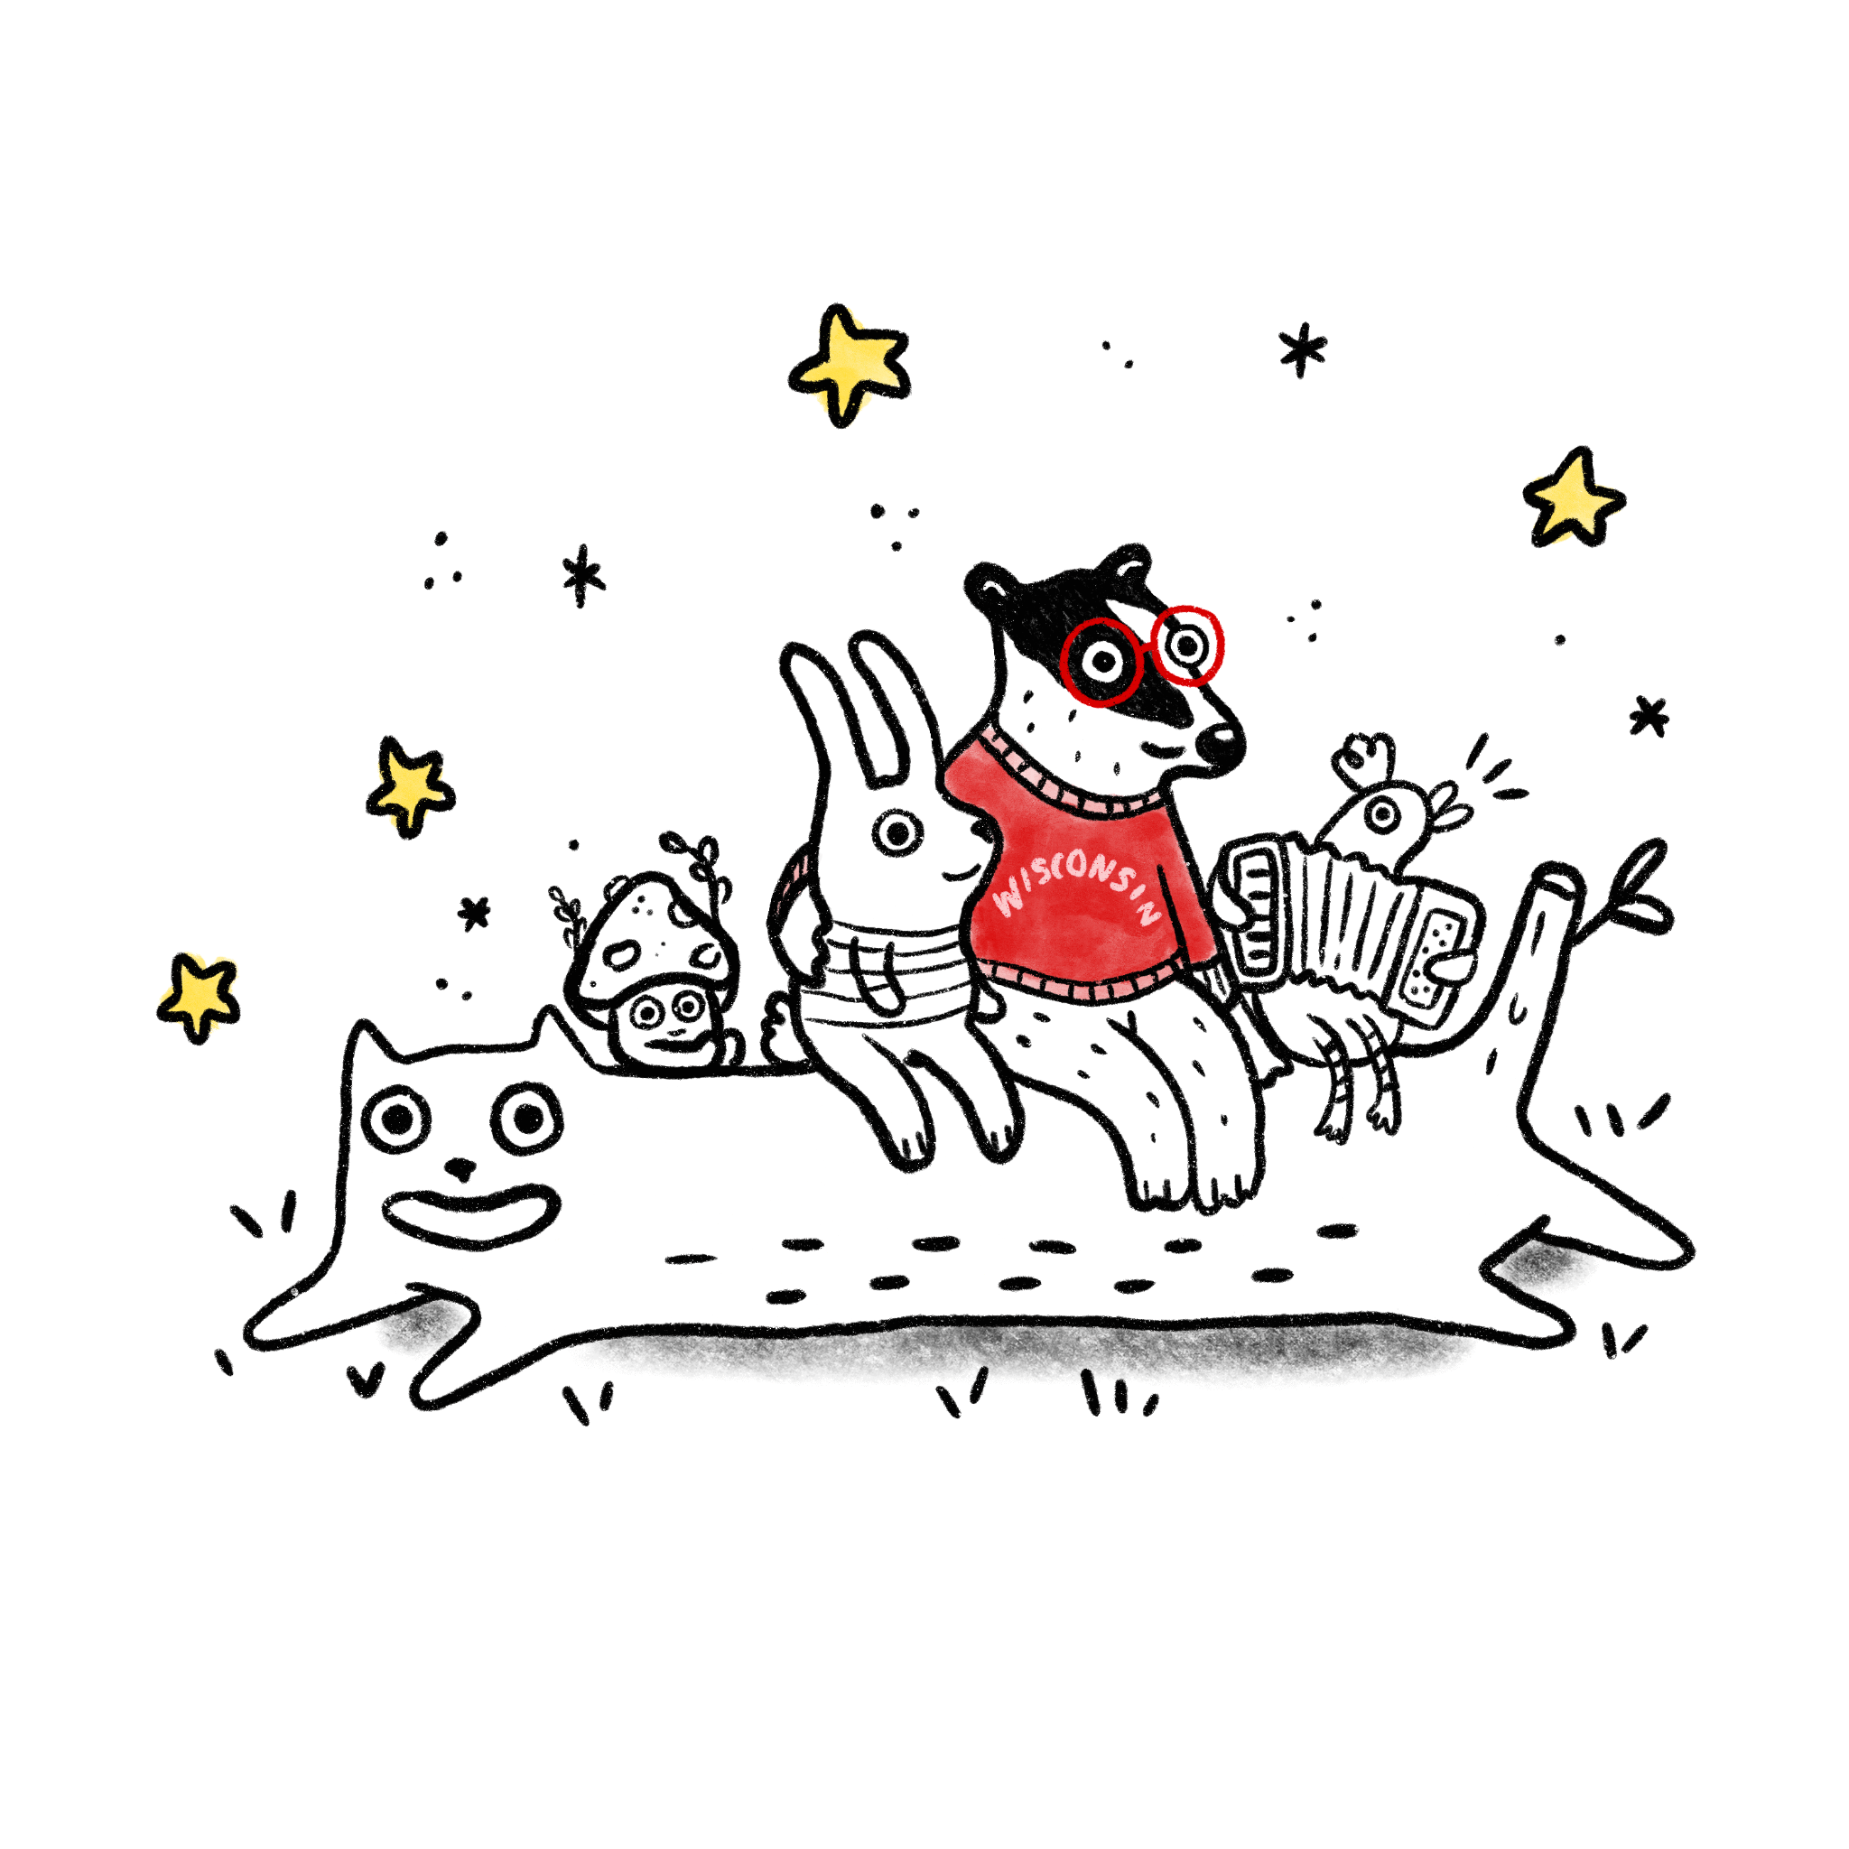
Design Community
Presented by the Center for User Experience
University of Wisconsin-Madison
Notes:
Minus 10m:
Turn on the virtual meeting
Turn on captions: CC Live Transcript
Roles - Speaker, person not speaking is monitoring chat
Make sure Jennifer, Beth, Karen are admins

Slide 2
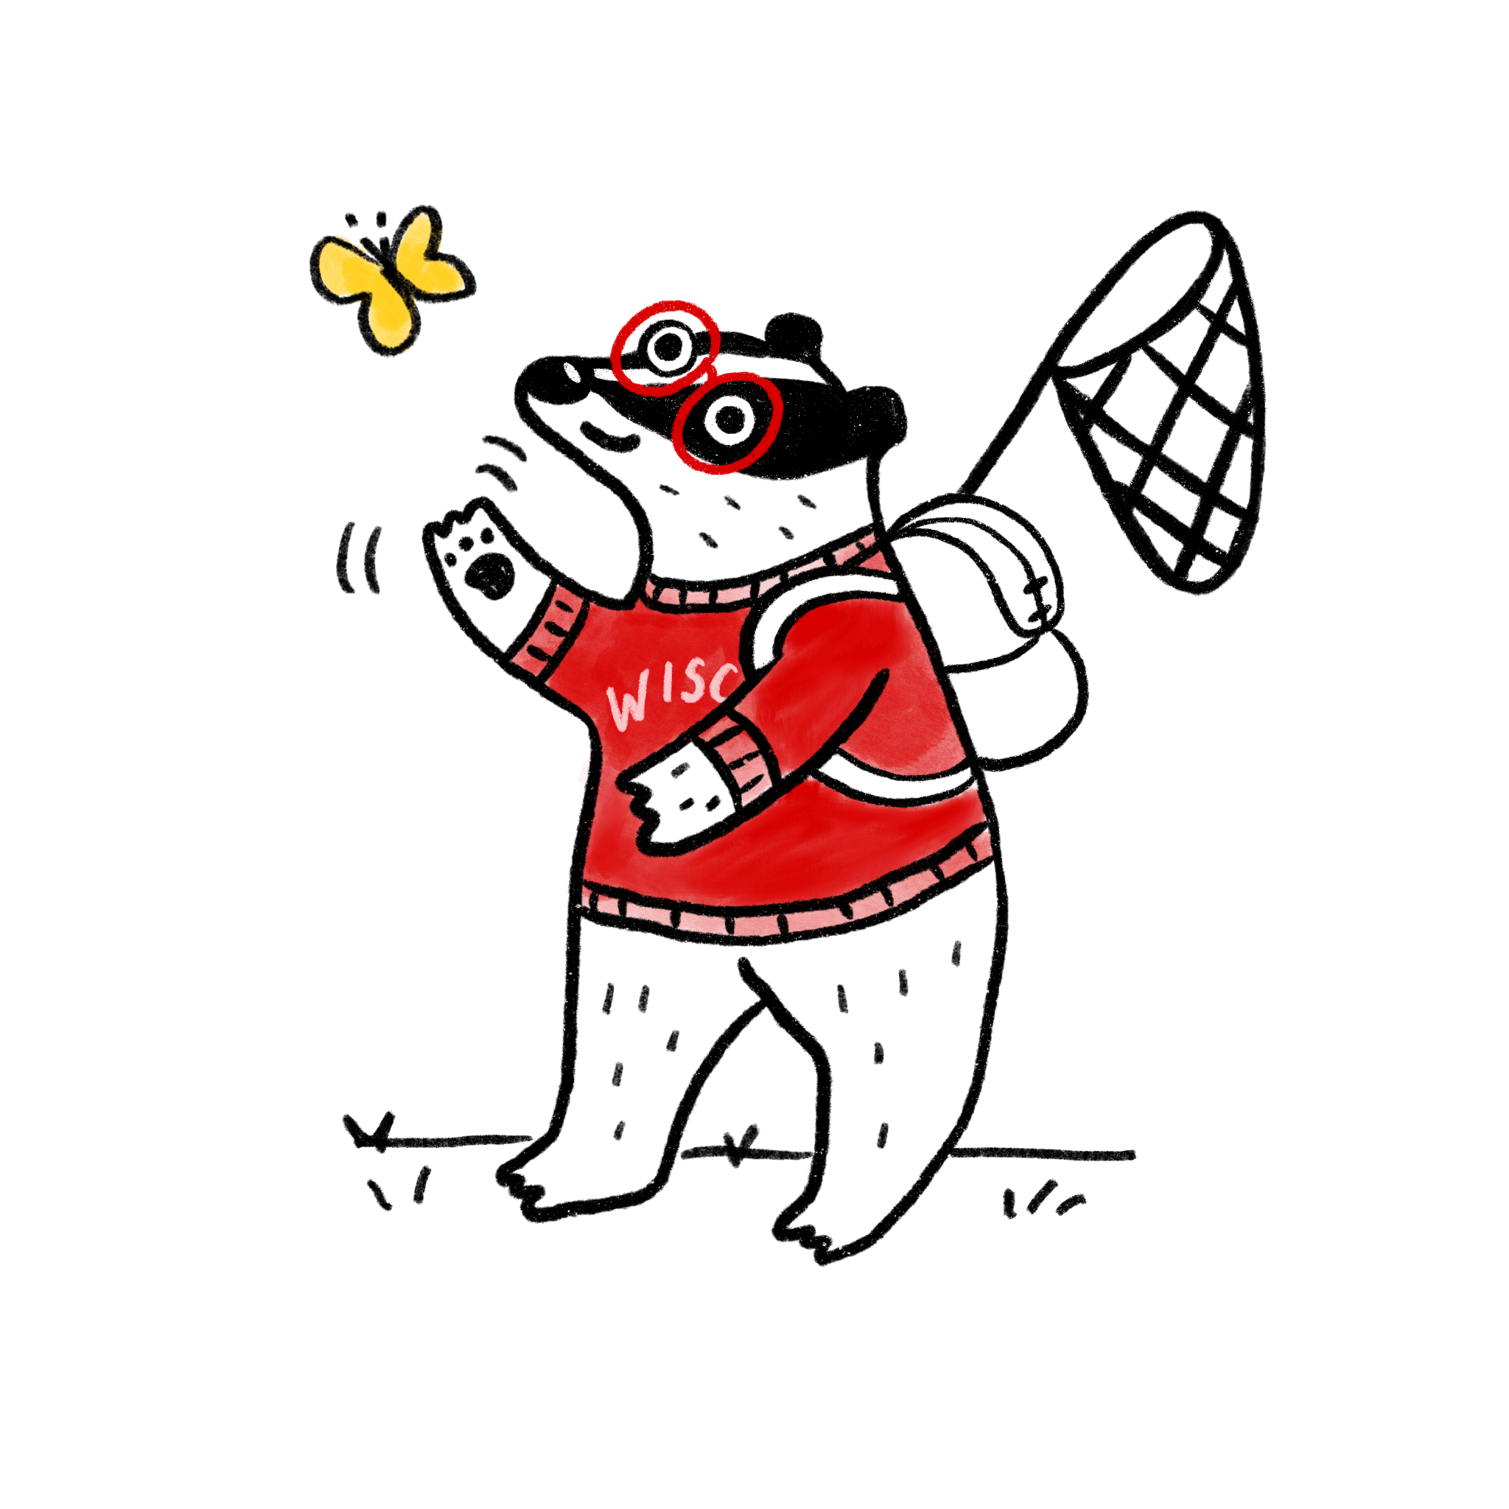
Hello
Design a better tomorrow for UW-Madison
Notes:
:00 Saying hello
[SWITCH SCREEN TO ADAM AND LAURA]
LAURA: Hello! Name. Title. Pronouns she/her. For folks who have no, low or limited vision or don’t have their screen on now (or are audio only), I’m a [gender], sitting [here], wearing [this], and here’s a description of the room [what’s behind me]. Adam . . .
ADAM: Hello! Name. Title. Pronouns. For folks who have no, low or limited vision or don’t have their screen on now (or are audio only), I’m a [gender], sitting [here], wearing [this], and here’s a description of the room [what’s behind me].
Today we welcome special guests Jennifer Sell, Karen Parillo (puh-R-ILL-oh) and Beth Gaytan (guy-TAHN) from Cultural Linguistic Services within the Office of Human Resources, but you might also know them as the folks who put the Plain Language Training Course together. They are our plain language advocates.
Jen, Beth and Karen, please introduce yourselves and give a quick background of how the Plain Language Training Course came to be at UW-Madison. [[ JEN, KAREN, BETH: INTROS,]]
Jen - Background of the course, 2 - 3min
ADAM: We welcome you to introduce yourself via chat, and what u do
ADAM: For a little bit of housekeeping . . .
Auto captions are available. Auto captions sometimes have issues and are not the same as equitable access. They don’t replace the need for a real-time translation.
Turn them on by selecting CC Live Transcript - a button, in the menu at the bottom of your zoom screen
If you experience an accessibility barrier, please reach out to Laura or Adam.
This event will be recorded with captions and a link to the video will be shared later along with the resources we cover today.
LAURA: We are going to be reviewing copy examples from a few websites today, and you’re going to make them better! Our intention is to learn from one another, not criticize each other’s writing. This is a safe space.
In addition to that, here are additional ground rules. I’ll place those in the chat.
Share the air - We agree to share our perspective, ideas, and narratives while allowing space for others to share their perspective, ideas, and narratives.
Believe people’s narratives - We agree to believe each other’s perspective, ideas, and narratives.
Confidentiality & permission - We agree to not share each other’s stories or narratives without permission.
Fully present and patient - We agree to listen to each other without distraction.
Default to inquiry over judgement - We agree to be curious and ask questions before making judgements.
Reflection Intent/ impact - We agree to reflect on how our intent and impact may differ or align.
Repair work and self-compassion - When our intent and impact do not align, we agree to:
Acknowledge harm, make a commitment to improve, and ask what is needed to move forward.
Be compassionate with ourselves while understanding we are all lifelong learners.
ADAM: Acknowledge the land that the University occupies
“We acknowledge the University of Wisconsin–Madison occupies ancestral Ho-Chunk land, and the inherent sovereignty of the Ho-Chunk Nation, along with the eleven other First Nations of Wisconsin. We acknowledge the land we are on -- not as a solution -- but rather as a first step that calls on each of us—to deeply consider our shared past and present with Indigenous peoples in this place, and to make our own personal and institutional commitments to achieve a shared future.”

Slide 3
What’s happening today?
1
Saying hello 5 MIN
2
What’s happening today? 2 MIN
3
Workshop 20 MIN
4
Design Takeaways 10 MIN
5
Questions
Notes:
[FLIP TO SLIDES]
:03 LAURA: Here’s our short agenda for today
Workshop it first - by practicing our plain language writing skills - give you examples of copy and you’ll have the opportunity to improve them.
Today’s design takeaway, lead by our plain language advocates, will cover the definition and importance of plain language, how to do it well, and how it’s connected to your user experience.
Questions segment: Answer your questions about the session and the Plain Language Course.

Slide 4
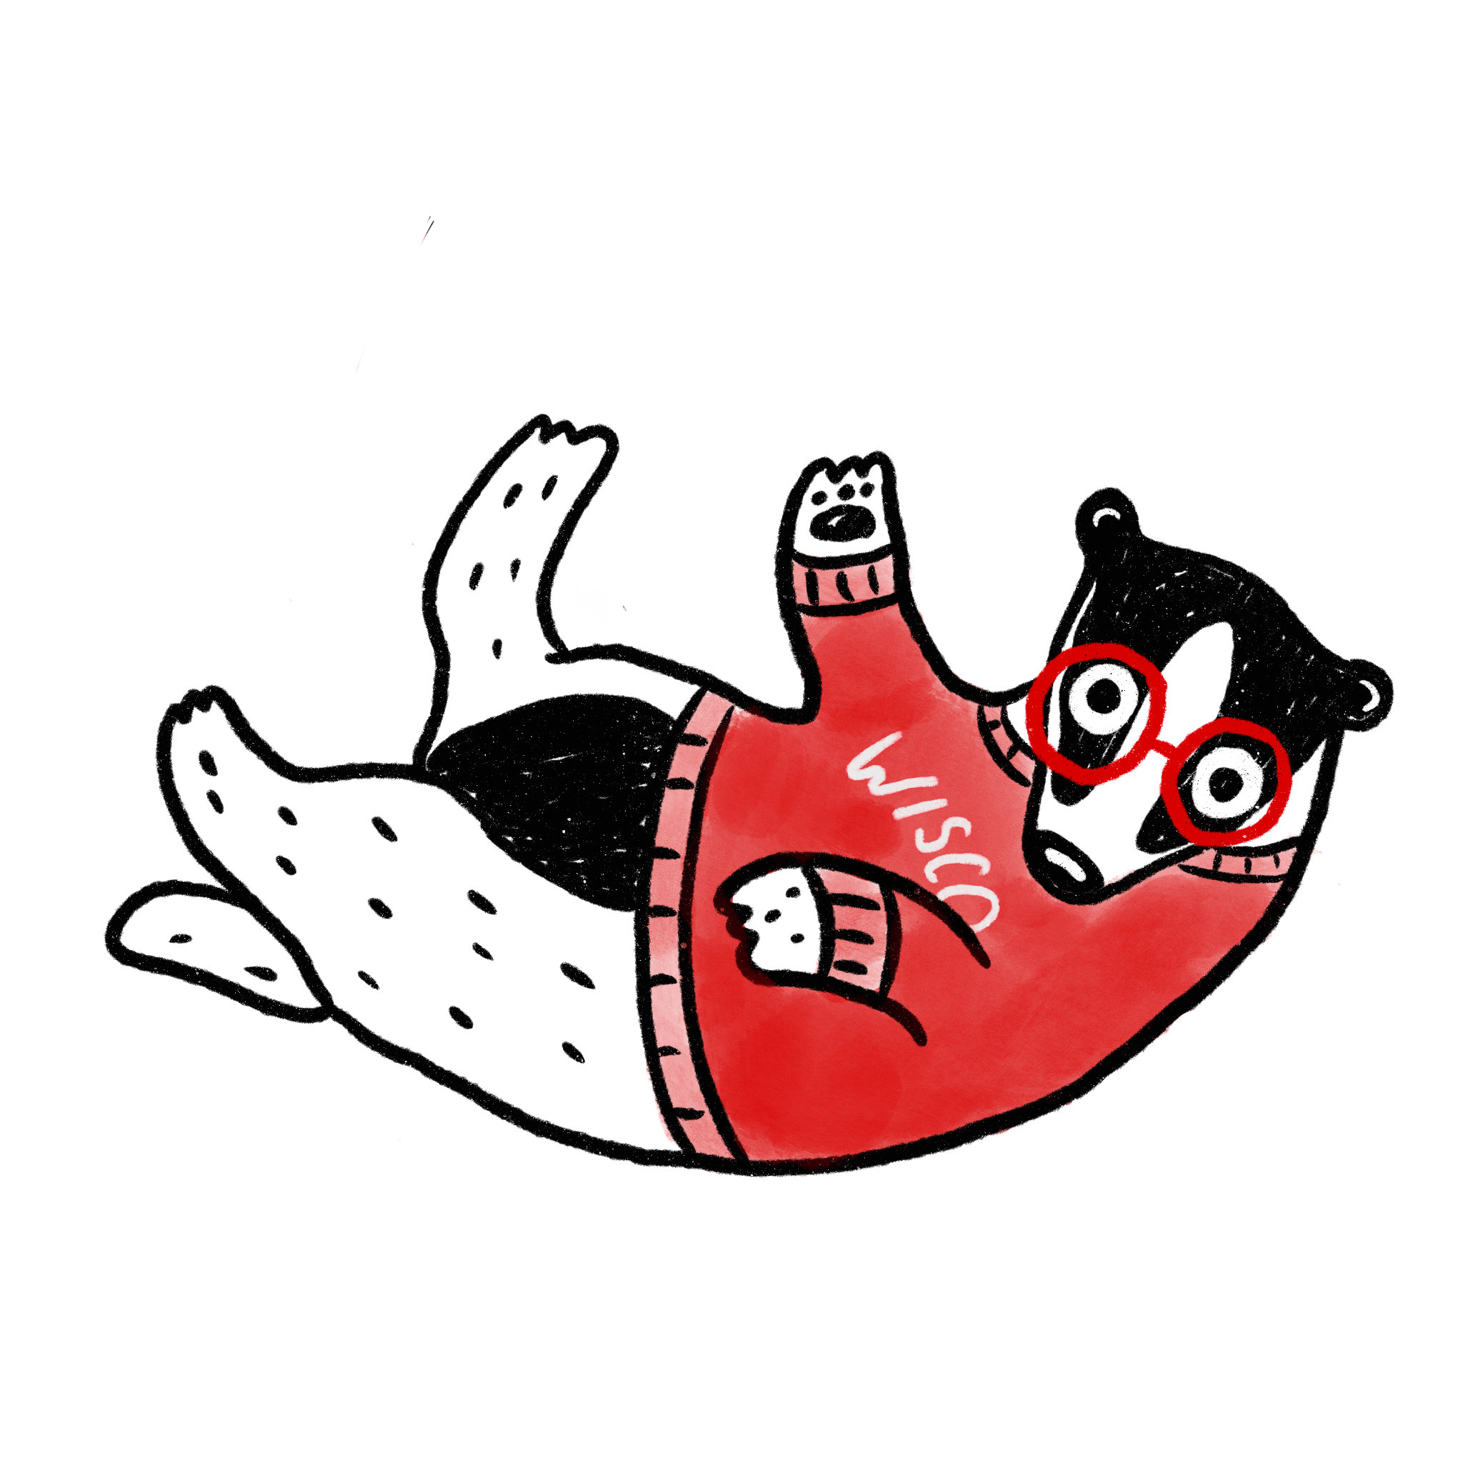
Workshop
Notes:
ADAM:
Trying something new - going to practice our skills first
Later learn about the Plain Language ideas behind it
Going to give you a Google Doc that we will work out of together [[Drop doc in chat]]
It’s got our copy examples. We want you to review it, improve it, and share it back with the community.
We’re giving you 5 minutes of working time to review and rewrite. You can mic and camera off if you want. Pick two. (Remember others will be able to see your rewrites, share what you are comfortable with)
After, we’ll review and look at what improvements were made - with our Plain Language advocates providing their feedback.
Quick questions before we start? Chat or mic on…
Walk through the Google Doc: https://docs.google.com/document/d/1D2DFLCFUxTAVfAn274qFZhPmKE3tWazTm76oPSDE110/edit?usp=sharing
NOTES:
5-7 minutes to work on rewrites; give 1 minute countdown
LAURA read first rewrite
Invite writer to comment on the choices they made
Invite Karen, Jen and Beth to comment on rewrites
ADAM read next example

Slide 5
Today’s takeaways
Notes:
:05 LAURA: Today’s Design Takeaway
Now that we’ve practiced writing copy that is easier to read and understand, we’re going to discuss the ideas behind plain language writing and why it’s important.

Slide 6
3 takeaways
Prioritization
Design Format
Content
Notes:
Three Design Takeaways Laura - [[pass to Beth & Karen ]]
Beth or Karen
Plain Language definition: PL means communication your audience understands the first time they read or hear it. It’s defined by results. Your audience can find what they need, understand what they find, and use what they find to meet their needs.
Strategies:
Prioritization
ADAM Tie in to UX: Want to give the user what they need first. Example: Apply. Put that button at the top of a web page
Design format: White space, font (design component)
LAURA Tie in to UX: Our goal with design is to make it easy for people to use and understand what you’ve designed. One way to do this is by using white space and varying font sizes to increase readability and text comprehension.
Content: Shorter sentences, few syllables, no jargon/acronyms, grammar (writing component)
ADAM Tie in to UX: people scan/look for key words. Keep things short. Example: apply vs. click here now to apply to our program.
3. Why is plain language important? (Jen)
We mentioned at the start that the federal government has invested a lot—why? The “bottom line” is when you speak and write so that more people understand you the first time, you save time, money, and energy explaining and fixing mistakes. People aren’t confused. They follow through better and faster, and they feel better doing it. Clear communication is essential for including, engaging, and gaining the trust of more members of our audience. PL text also makes the job easier for interpreters and translators. (A&L: Users understand the consequences; Easier to get the conversion (whatever it is you want people to do: sign up, go to cart, etc.)
ADAM: those are our takeaways - if you want to learn more there’s a training course to reinforce what we’ve covered today…..
BETH: PROMOTE OPPORTUNITY: Plain Language Training course
LAURA: Some of you are Comm/writer/dev teams of one, who can benefit from this campus training resource. And some of you are fortunate enough to have Communications Departments like DoIT who are well versed in Plain Language that can help you out with your writing.

Slide 7
Join us next time...
Notes:
LAURA: That wraps up today’s session.
In the next day or two, sharing resources via the email list.
Get your friends to sign up.
Contact us/with ideas.
Next session will be held late February. The topic will be UX Research: how and when to use different methods.
ADAM:
Thanks to you, Kedar Joyner, Jen Sell, Karen Parillo and Beth Gaytan from Cultural Linguistic Services, the rest of the Center for User Experience including Director Jess Jones.
We’re happy to take questions from the audience.

Slide 8
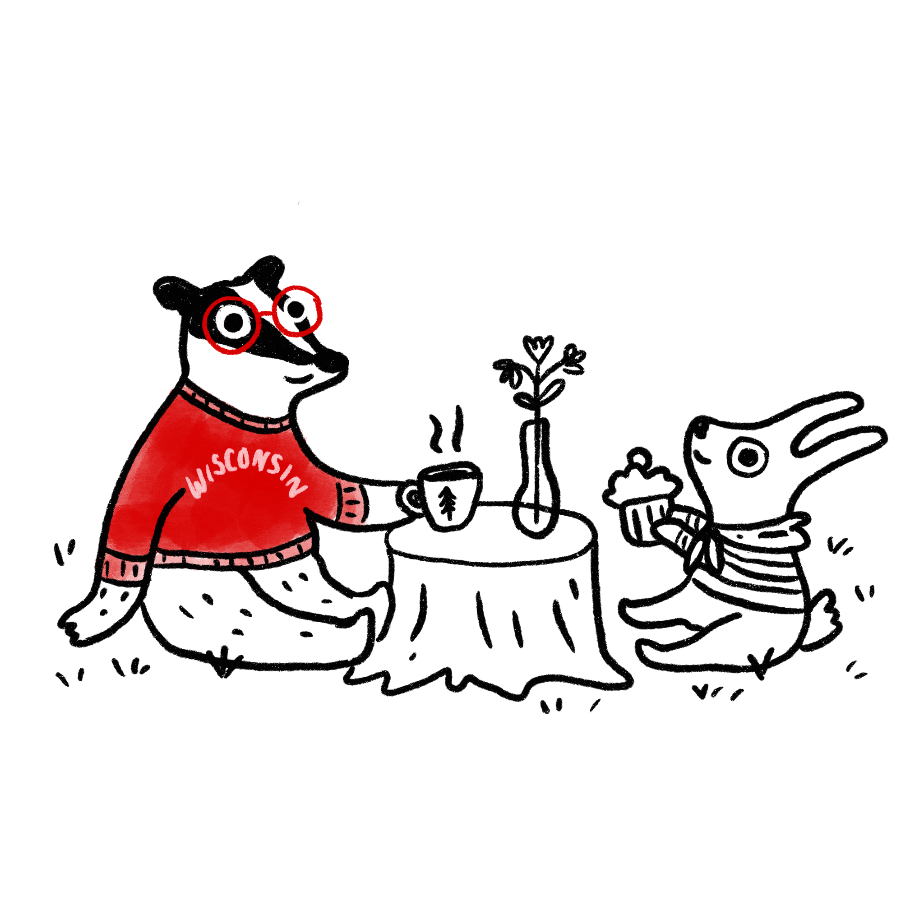
Questions?
Notes:
[SPEAKER]:
Time for Q&A

Slide 9
Thank you
UW-Madison’s Center for User Experience

