Slide 1
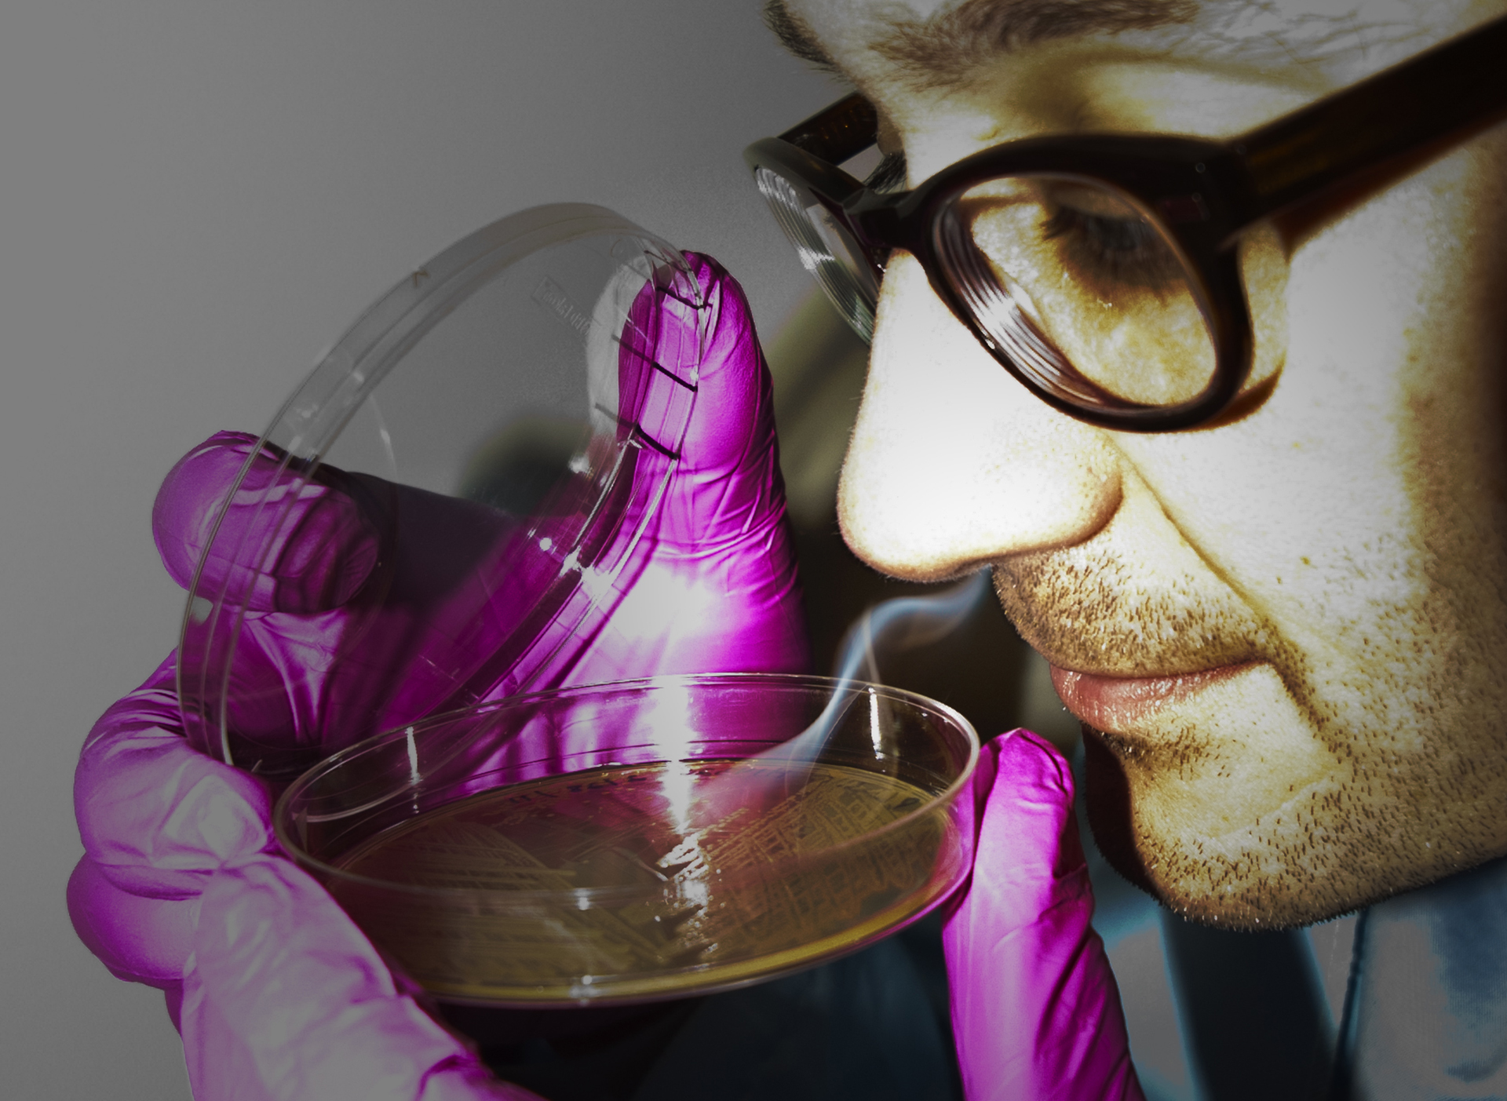
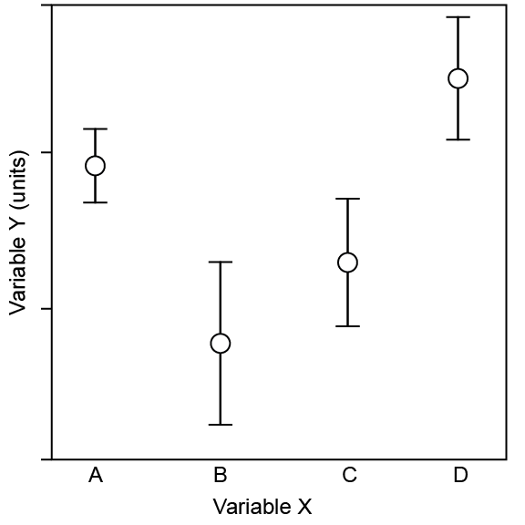
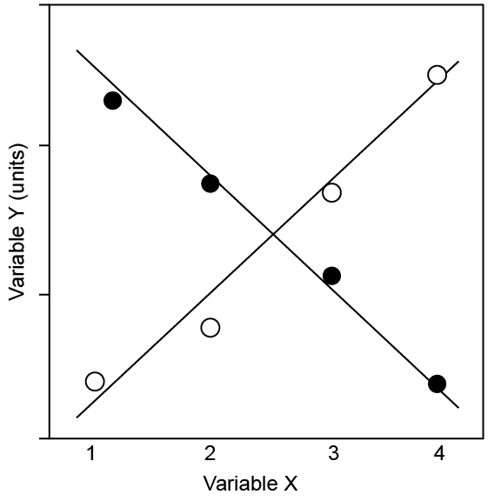
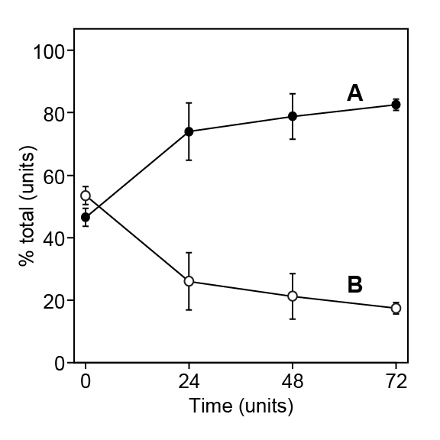
Title, in sentence case (Not Title Case and NOT ALL CAPS), two lines max, font size ±105 points
Authors and affiliations, font size ±72 points
Contact information, font size ±60 points
Introduction, ±60 points
Results
Tidbits
Two or three sentences to hook your viewer. Consider your audience. Are you presenting to experts, or a mixed audience?
Typography research has shown that body text is easier to read if you use a serif font. 32 points.
Keep in mind that people read left to right and top to bottom. Give the reader clues on how to travel through the components.
Describe the experiment, answer the question.
Space is important. Keep figures and legends carefully separated.
Avoid tables. Use colored text or arrows to draw attention to important details.
Paragraph format is fine, but bullet lists of results are more noticeable.
If you need to change the size of your poster after you have started
Select your entire poster content
Copy
Delete
Make your new poster size
Paste your poster into your new size, and rearrange as needed
In using bullet points and line spacing be sure to check under
Format > Paragraph as well as Format > Bullets and Numbering
The default style is not necessarily the best option.
Materials and methods
Figure 2.
Color draws attention. Be careful where you use what. Red means stop and notice me! Photo: UW-Madison Biochemistry MediaLab
Be brief. Use photos and illustrations to convey your experimental approach. Images say more than words.
Figure 1.
Use quality images. 300 dpi at 100%. Web files are insufficient resolution. Cite your source.
Photo from UW-Madison Archive
Graphs.
Don’t use a key, label the elements and use shape, as well as color to differentiate your data points. Is your graph understandable in grayscale?
Eliminate chart junk, keep focus on the data. Simple is better.
Don’t minimize font size in legends. Viewers do want to read your results.
Conclusion
Do not restate your results. Guide the reader through what your results have concluded, and why those conclusions are important.
What are your future directions?
Prepare a 3-5 minutes verbal explanation. Be ready to walk people through your poster. Don't read the poster. Give the big picture, explain why the problem is important, and use your data to support your findings and recommendations. Prepare a summary handout. A handout provides a written record for readers. Create a miniature version of your poster plus more details if desired. The mini is something you can refer to when talking to people about your work. Be sure to include your contact information.
You can delete this text box after reading
This poster template might need to be resized to fit your needs. Do the resizing before you replace the “Title” with your own text and definitely before you add graphics (or they will get distorted).
Layout
There are many options for layout. Keep in mind that your goal is to have your research stand out. Will you be standing by your poster to explain in person? Will it stand alone?
Make sure your fonts are the same size. Padding around text makes it easier to read. Make sure alignments and spacing are consistent. The “align” tool is your best friend. (Arrange > Align)
Aim for 500 words total.
Find out the meeting size requirements! Layout options:
Literature cited
Use standard notation for acknowledging and listing publications
Figure 4. Can you read your poster from six feet away? You should check.
When resizing images, hold the shift key to keep proper aspect ratio.
Pay attention to the red zigzag underlined words – fix the typos, add frequently used science terms to your dictionary.
Hold the shift key down when drawing a line to keep it straight
To check line straightness: Shape Format, look at Height & Width
If straight, one of the numbers will be 0.
Acknowledgements, funding
Don’t forget you funding sources!
Yep, you can include the Biochemistry MediaLab here.

